Slide 1
Smart devices sensors programming
Assistant : Simonas Česnauskas

Slide 2

Overview of electronic components
What is electronics?

Slide 3
What is electronics?
Electronics is the science of controlling the flow of electrons. It involves circuits that are made up of parts called components, and connecting wires / conductors that control the flow of electricity and direct it to do useful things or turn them into electrical current and voltage signals to store information.

Slide 4
Resistors, their types and encodings

Slide 5
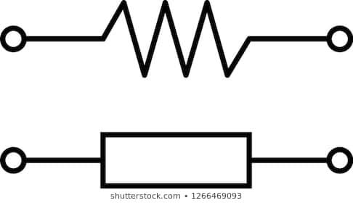
Resistor
It is a device of a certain resistance used to generate the required voltage. It resists the electric current flowing through it, creating a voltage drop between the contacts (because there is no longer enough current to carry the voltage). It releases the voltage that falls on the resistor to the environment in the form of heat. This relationship is described in Ohm's law.

Slide 6
Resistors types
Carbon composition resistors;
Metal / carbon film resistors;
Wire wound resistors;
Variable resistors;
Potentiometers;
Light dependent resistor / photoresistor;
SMD resistors;
Varistors;
Thermistors;

Slide 7
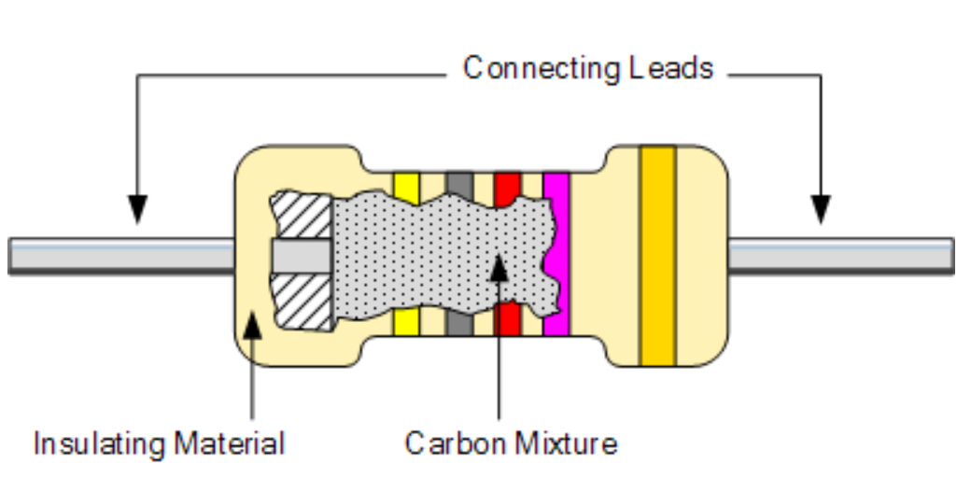
Carbon composition resistors
Because the manufacture of these resistors is relatively inexpensive and simple, they are quite common. However, due to its composition, distortions and noise may occur at high temperatures. Therefore, they are most commonly used in schemes that want cheapness rather than quality performance.
They can be found from 1 (Ohm) to 22 mega (ohms);
They can be found from 0,250w up to 5w.

Slide 8
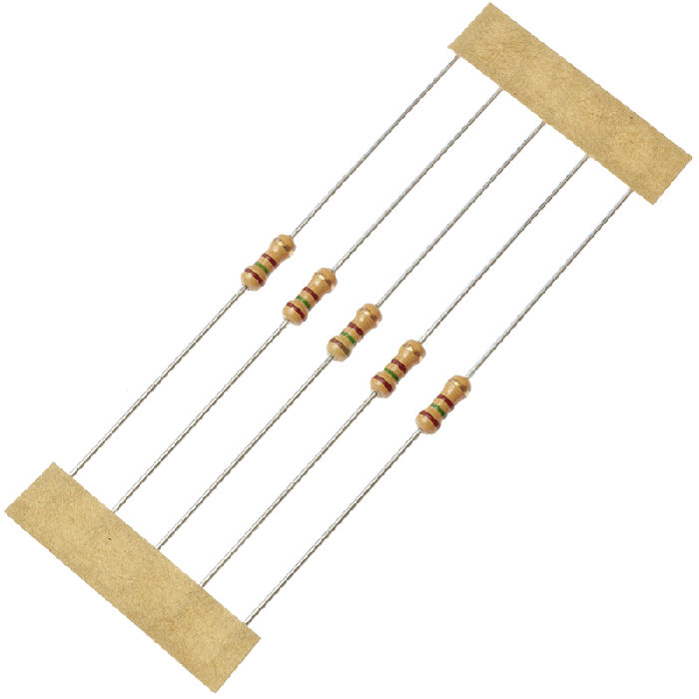
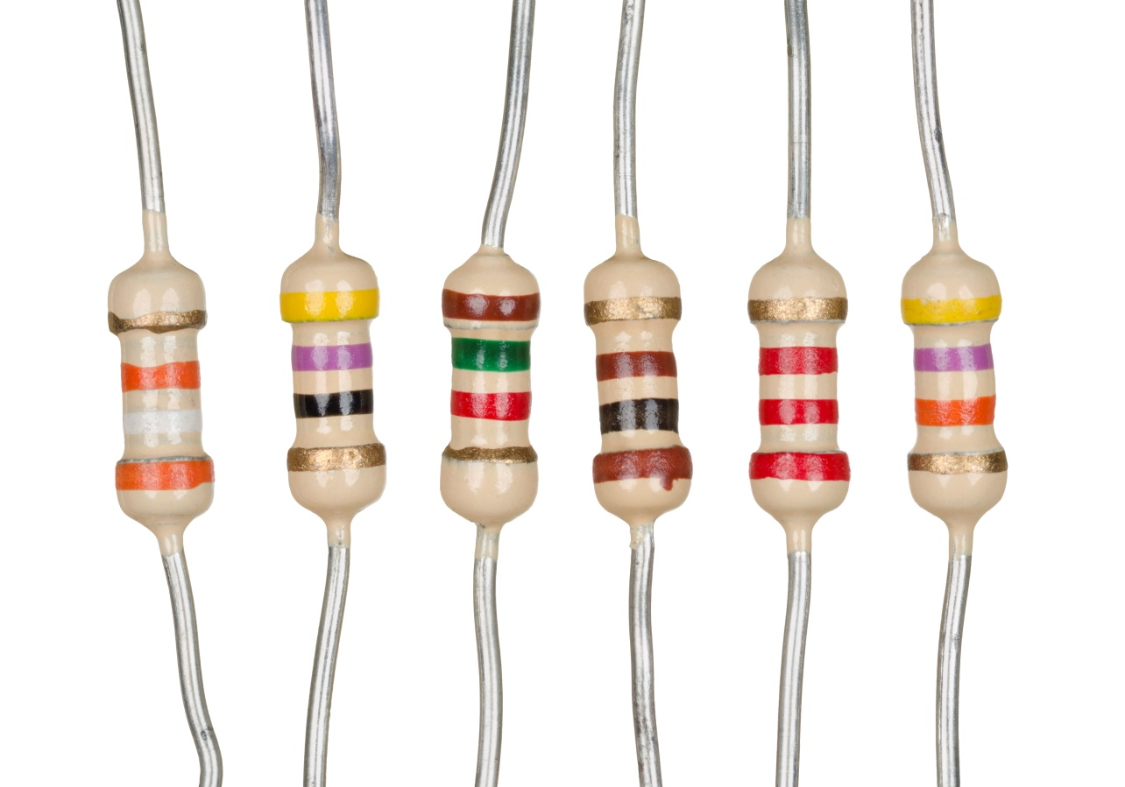
Carbon composition resistors

Slide 9
Metal / carbon film resistors
The composition of these resistors, as the name implies, consists of an impermeable core on which a layer of either carbon or metal particles is deposited in a very thin layer (like a film), which creates the resistance of the component.
The resistance rating is adjusted by controlling the thickness of the layer of particles (film) deposited on the surface.
Or along the component, making a cut in the film, thus reducing the amount of material and at the same time the resistance.
This type of resistor can be found up to a nominal value of 10000Mohm.

Slide 10
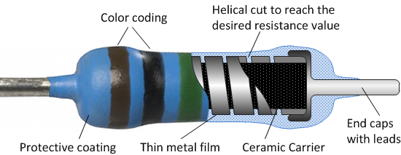
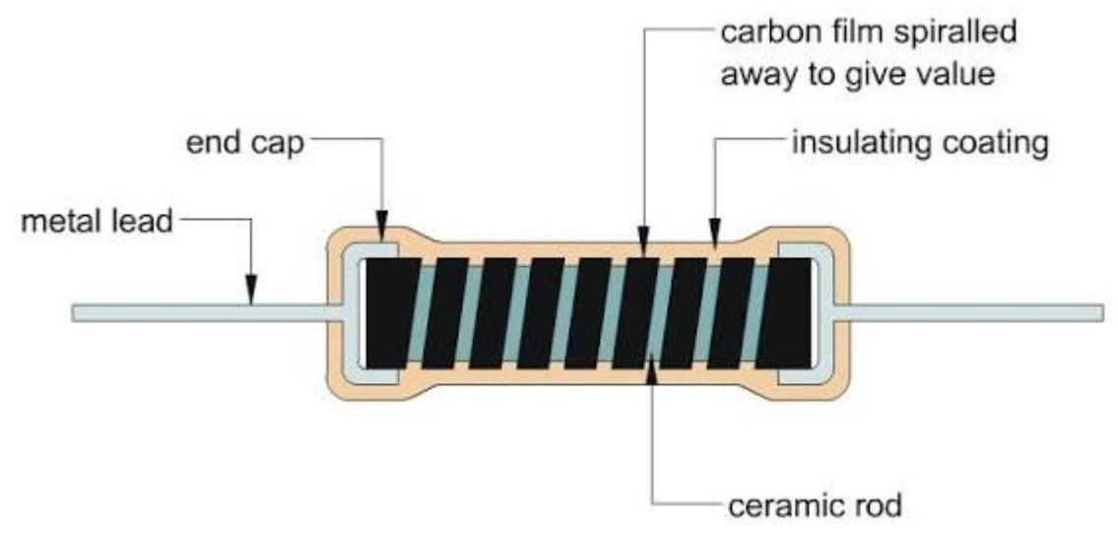
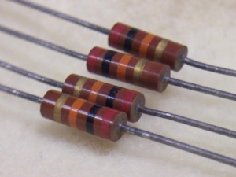
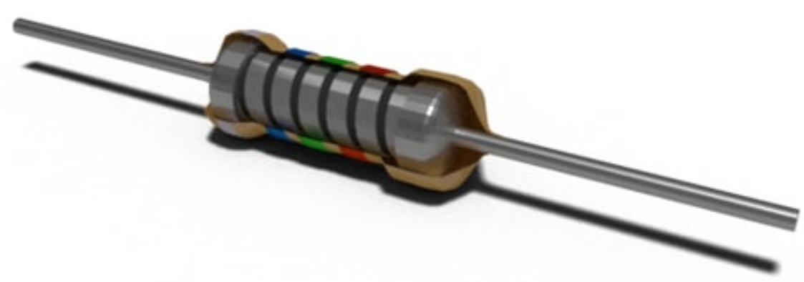
Metal / carbon film resistors

Slide 11
Color codes for 3 to 4 band resistors
The first two bands always indicate the resistance value in ohms;
The third band indicates the multiplier from which we will multiply the resulting resistance value;
The fourth band indicates the tolerance of the resistor;
If a 3-band resistor is used and the fourth band is not available, the tolerance of such resistors shall be ± 20%.

Slide 12
Color codes for 5 to 6 band resistors
These are more accurate resistors because the denomination of the value is indicated by three numbers. So the first three bands indicate the resistance in ohms.
Everything else remains as in the color codes of the 3-4 band resistors. The fourth bar indicates the multiplier.
The fifth bar indicates the tolerance of the component.
The sixth bar can indicate either the reliability rating or the temperature dependence of the resistance.

Slide 13
How to understand color code?
The color code is read from left to right;
Usually the strips on a component are placed closer to one edge than the other. Thus, the edge to which the strips are placed closer is read as the beginning;
Or the strips on one side of the component are stacked more densely. Then this side will be the beginning;
The color code never starts with a metallic color (gold or silver), so if there is such a bar, it will by at the end.

Slide 14
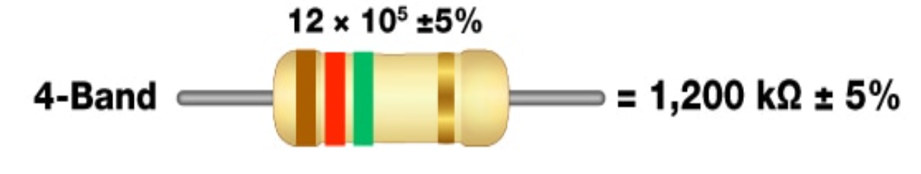
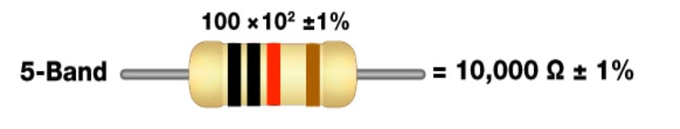
How to understand color code?

Slide 15
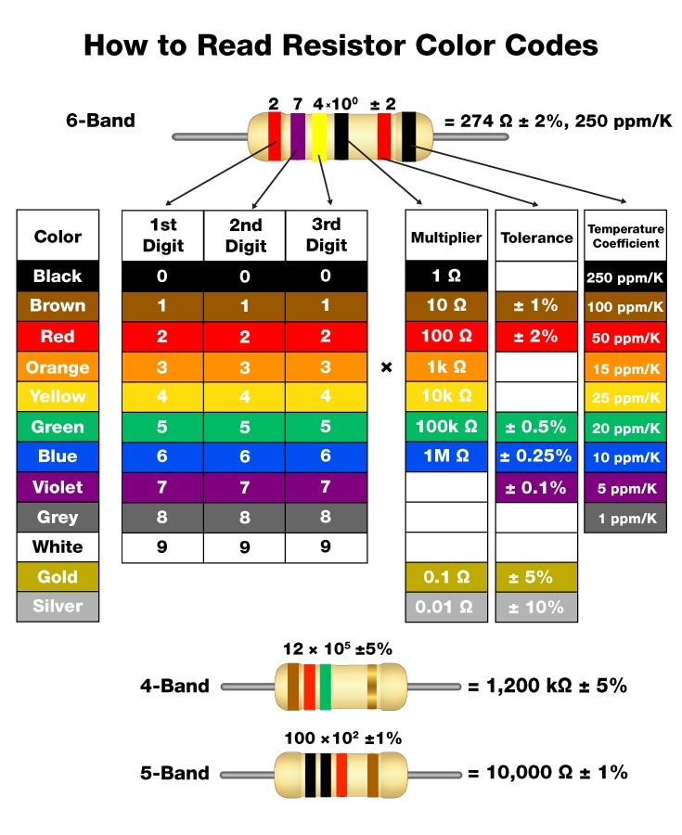
Color code table

Slide 16
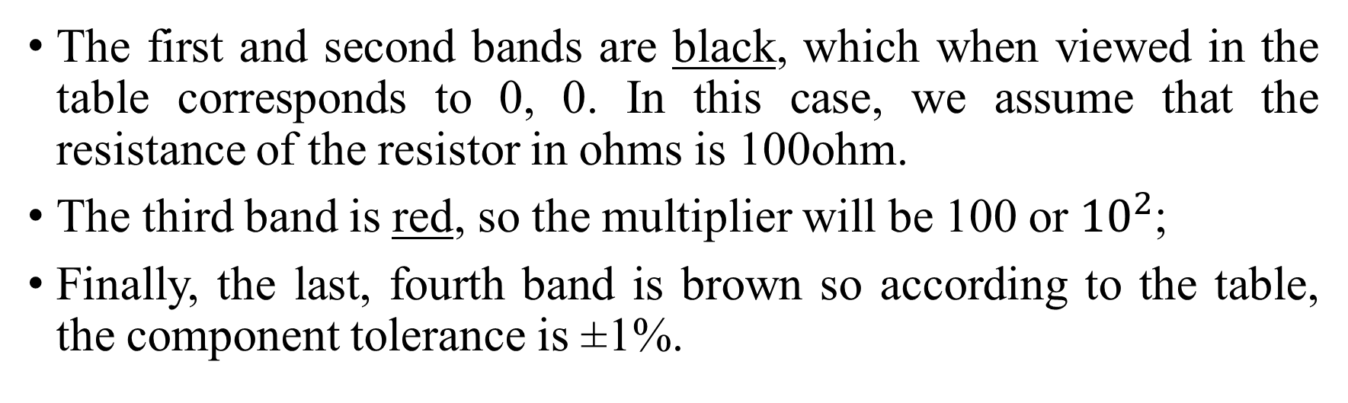
An example of understanding color coding
The first and second bands are black, which when viewed in the table corresponds to 0, 0. In this case, we assume that the resistance of the resistor in ohms is 100ohm.
The third band is red, so the multiplier will be 100 or ${10}^{2}$;
Finally, the last, fourth band is brown so according to the table, the component tolerance is ±1%.

Slide 17
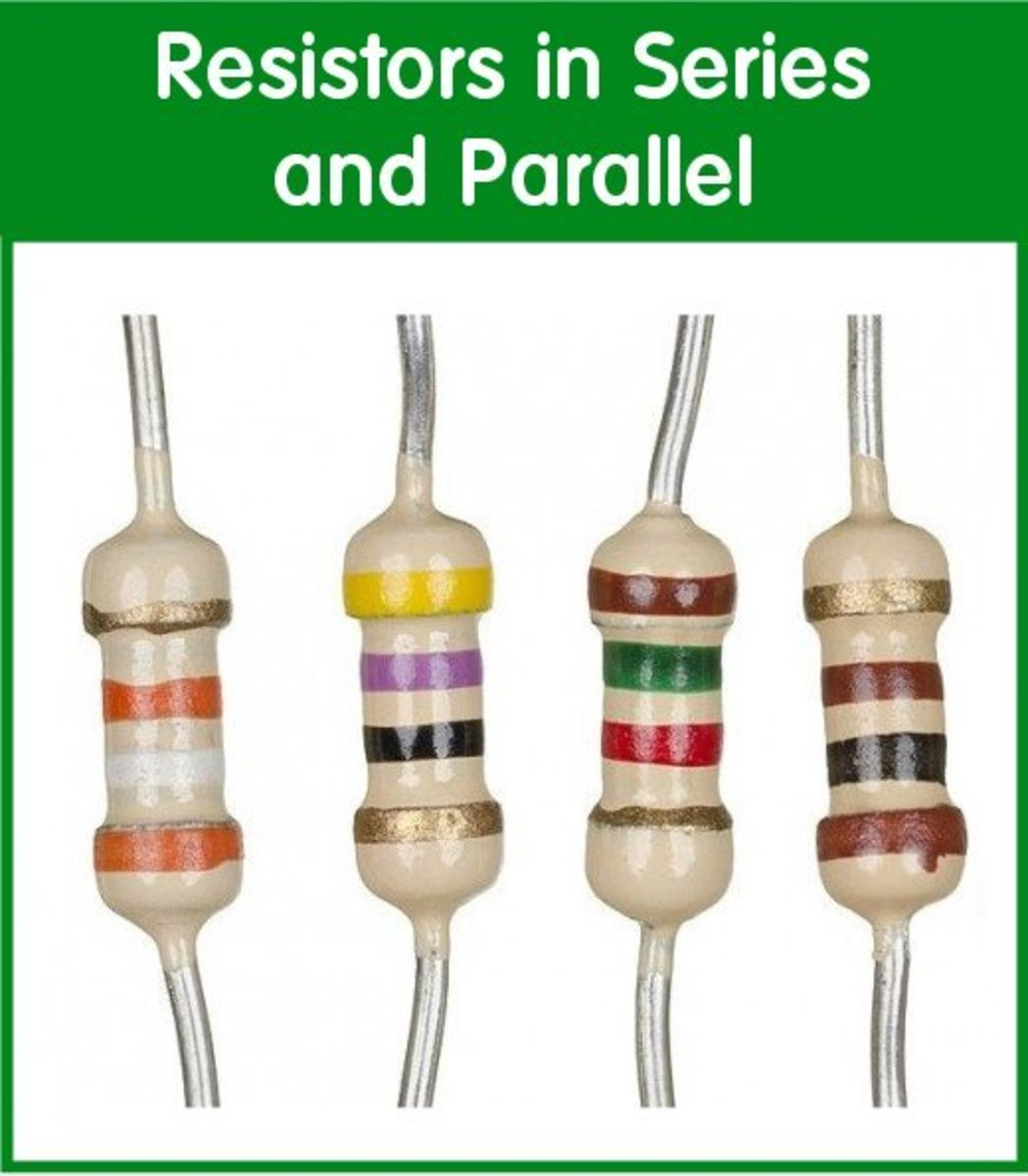

Which resistor is in the correct position?
A
B

Slide 18
What is the resistance of this resistor?
Colors: Brown, red, green, gold.

Slide 19
Resistor resistance

Slide 20
Wire wound resistors
They consist of a metal wire of appropriate resistance wrapped around an impermeable core.
The metal wire is usually either a nickel-chromium alloy or a copper-nickel manganese alloy.
These are the oldest type resistors.
They can withstand large amounts of power (w) and can become very hot during operation. Therefore, newer resistors of this type are housed in aluminum housings to dissipate heat more efficiently.

Slide 21
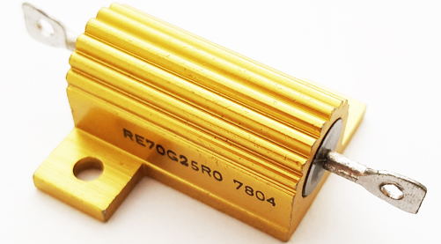
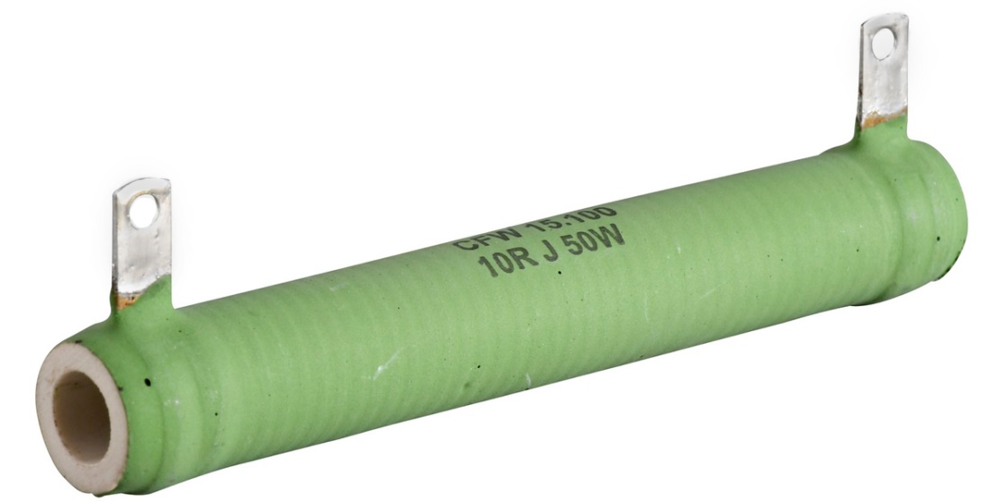
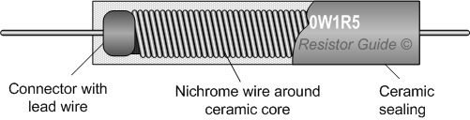
Wire wound resistors

Slide 22
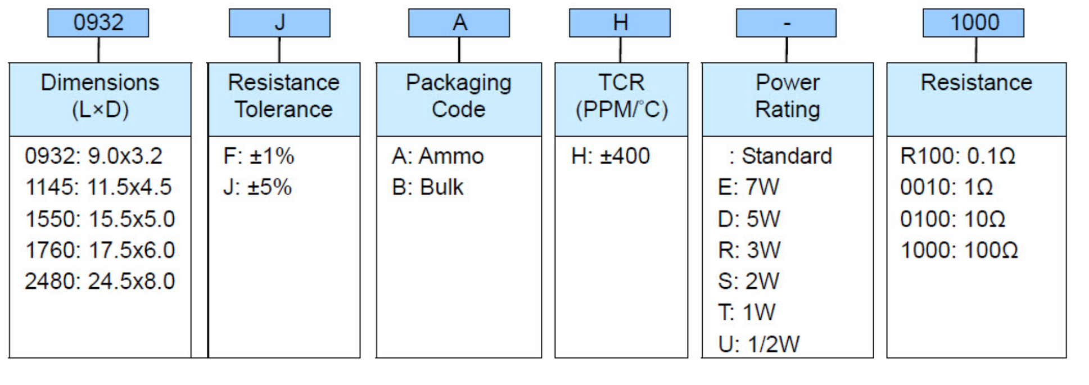
Wire wound resistors
The codes for this type of resistor are usually quite simple and the information is written directly on it because the component itself is quite large.

Slide 23
Example of wire wound resistor code
Code: 10R J 50W
Resistance : 10 omų;
Tolerance : ±5%;
Power : 50 watų.

Slide 24
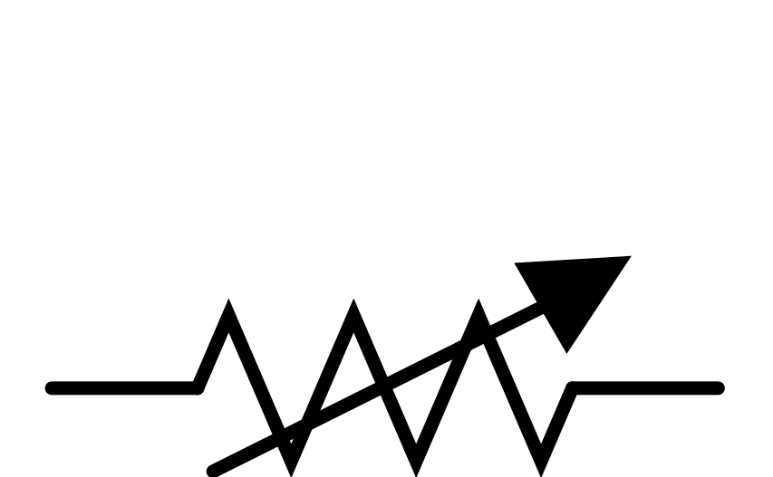
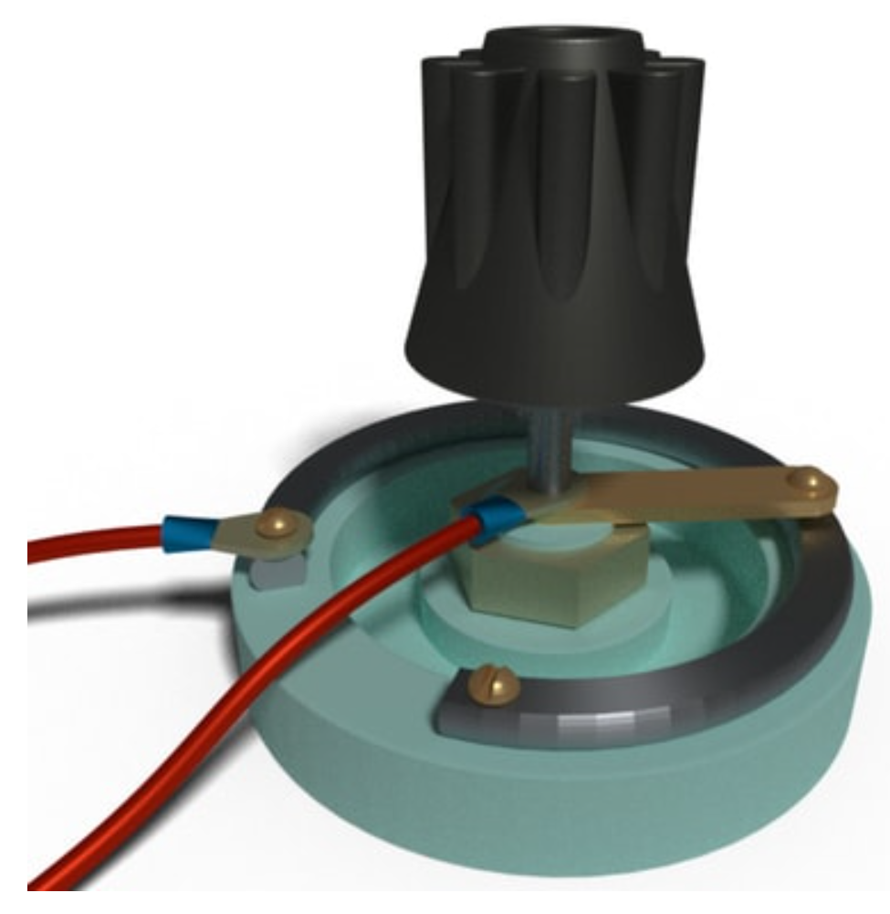
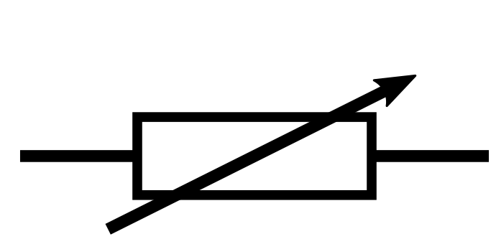
Variable resistors
As the name implies this is an adjustable resistance resistor.
The essence of this type of component is a certain resistive material and contact, which is moved around or along it, thus changing the resistance between the ends of the contacts.

Slide 25
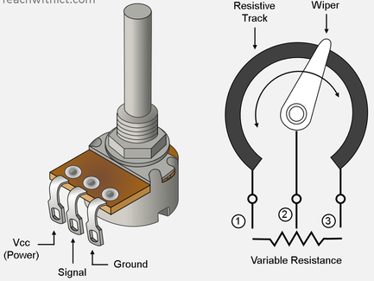
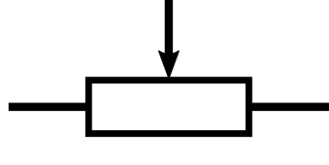
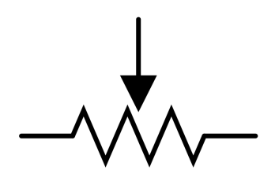
Potentiometers
Iin principle they are very similar to dimmable resistors and can be used as variable resistors if only 2 of the 3 contacts are used.
Unlike adjustable resistors, the resistance of the potentiometer does not really change, the potential changes on the central moving contact, as a result of which this component can be thought of as a voltage divider..

Slide 26
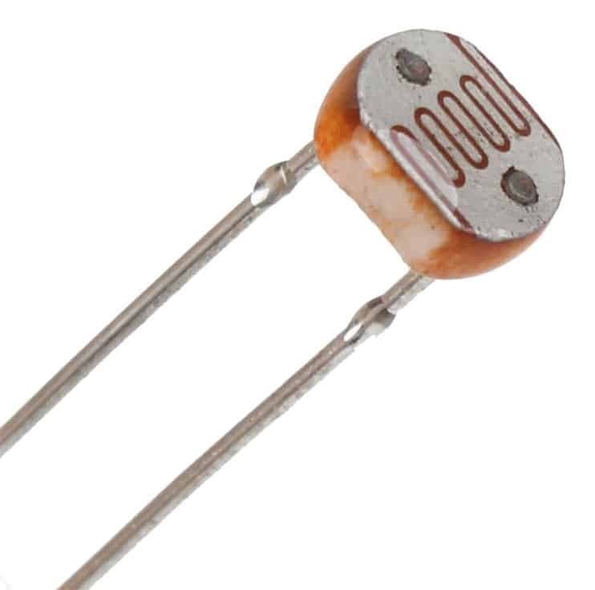
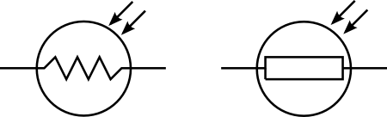
Light dependent resistor / photoresistor
These are components that change their resistance depending on the intensity of the light falling on it.
They usually have a high resistance when in the dark and a significantly lower resistance when in the light.

Slide 27
SMD resistors
To understand what these components are, we need to discuss the methods of component assembly on the printed circuit board. Two component assembly methods are used in the design and implementation of printed circuit boards (PCBs).

Slide 28
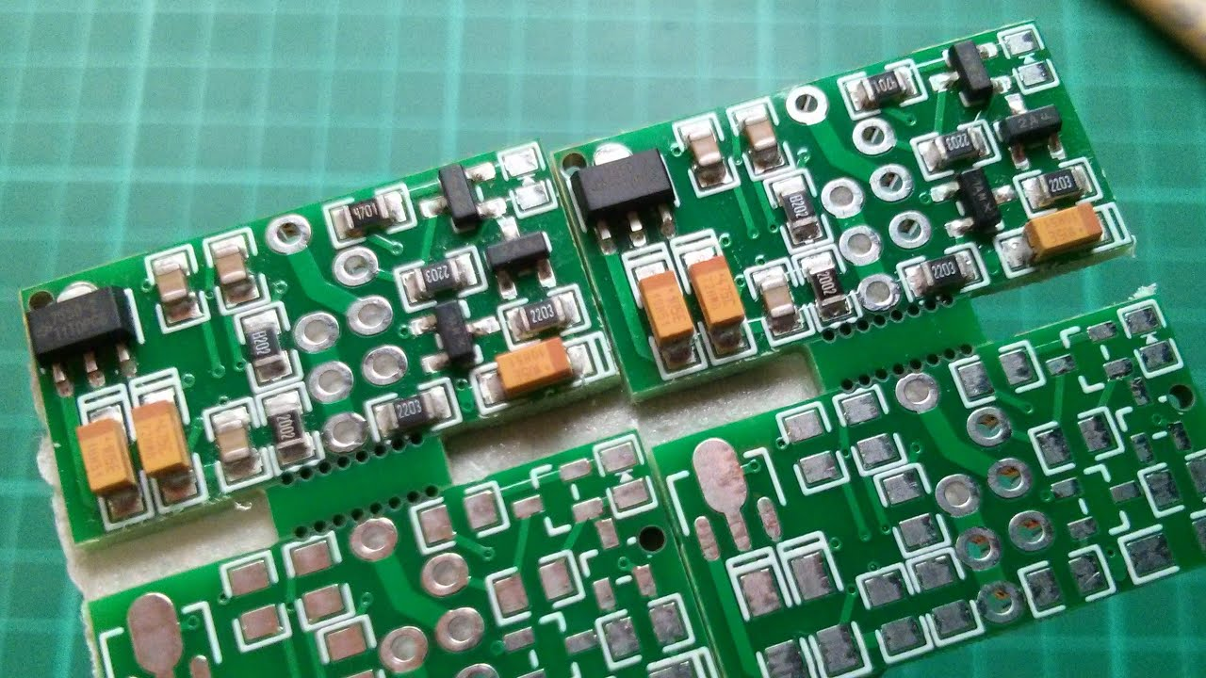
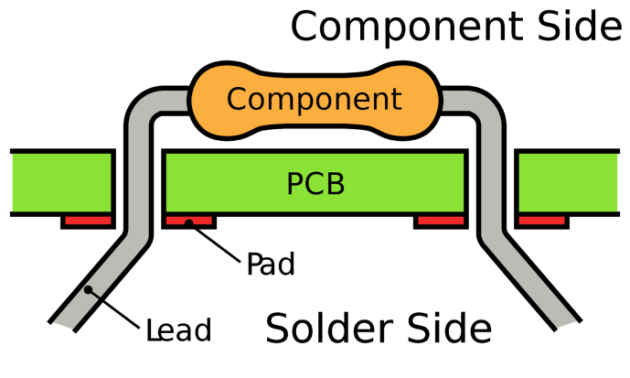
SMD resistors
SMT- Surface mount technology, components that are soldered / mounted on one side of the board (picture on the left).
THT – through hole technology, components are mounted by inserting contacts through a printed circuit board and soldered on the other side (picture on the right).

Slide 29
SMD resistors
Thus, SMD resistors are resistors that are mounted and soldered on one side of the board.
Compared to simple THT resistors, their shape is usually square and they are significantly, significantly smaller than simple resistors.
The size of SMD components is determined by their package. It basically describes the size of the components used in it. The most commonly used SMT package is 0402. The size of the resistor included in this package can be approximately 1mm x 0.5mm.

Slide 30
SMD resistors
Due to the small size of the components, it is no longer possible to use color codes to separate them, so the coding of SMD resistors consists of numbers.
3-digit encoding;
3-digit encoding;
New EIA-96 encoding.

Slide 31


SMD resistor, 3 digit coding
As with color band coding, the first 2 digits indicate the resistor resistance and the third digit indicates the multiplier..
If the resistance of the component is less than 10Ω, the letter R is used.
$$10 × {10}^{2} =1000Ω or 1kΩ$$

Slide 32

SMD resistor, 3 digit coding
3,3Ω

Slide 33

SMD resistor, 4 digit coding
As with the color band code, same here. The resulting additional number allows you to more accurately determine the resistance of the component and everything else shifts to the right.
The first 3 digits indicate the value, and the remaining digits indicate the multiplier.
$$100 × {10}^{2} =10000Ω or 10kΩ$$

Slide 34
SMD resistor, EIA-96 coding
The component is marked with 3 characters.
The first two are always numbers indicating the value of the resistance in the form of 3 numbers.
The last character is a letter indicating a multiplier.

Slide 35
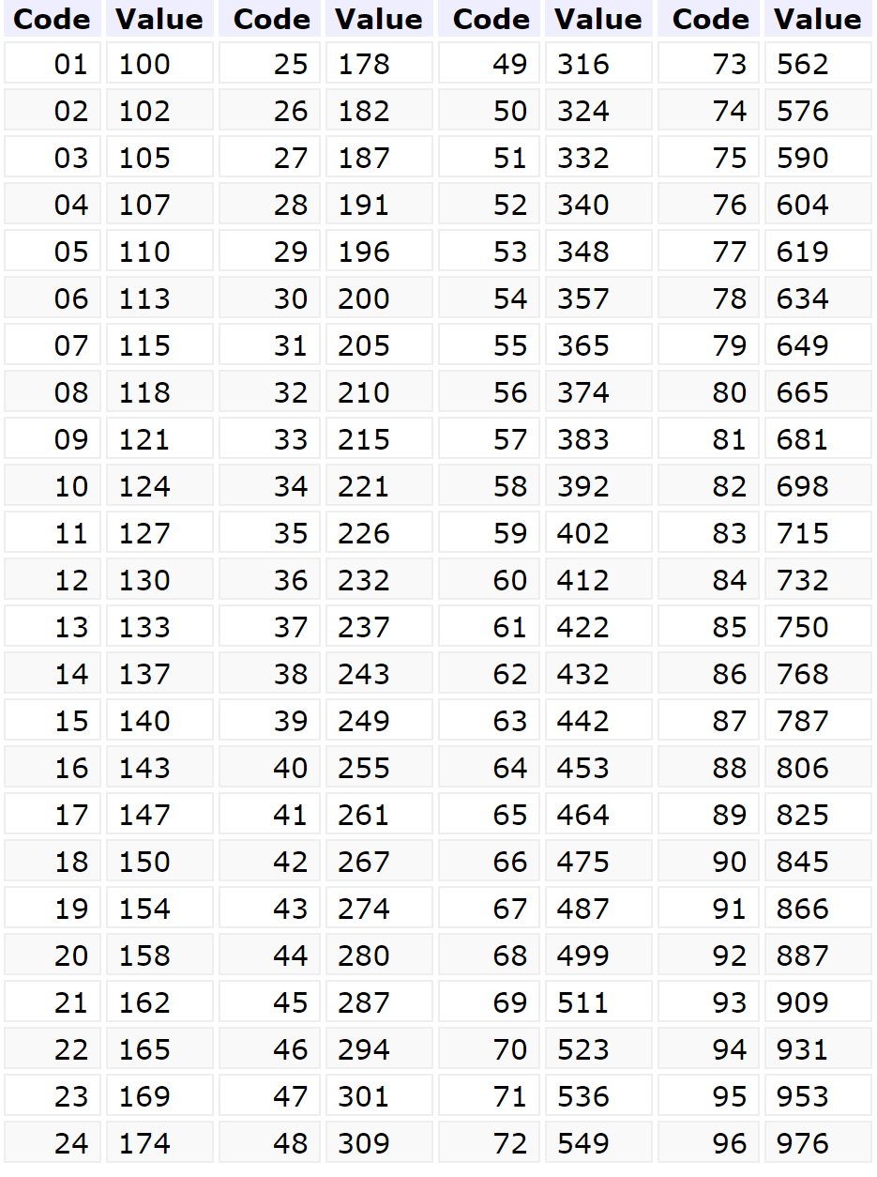
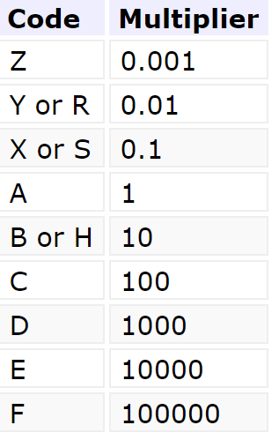

SMD resistor, EIA-96 coding
$$105 × {10}^{1} =1050Ω or 1,05kΩ$$

Slide 36

What is the resistance of this SMD resistor?

Slide 37
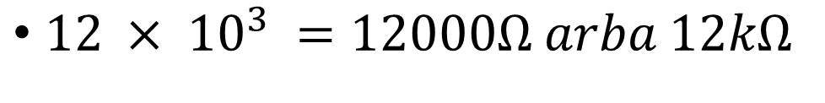
The resistance of this SMD resistor
$12 × {10}^{3} =12000Ω arba 12kΩ$

Slide 38
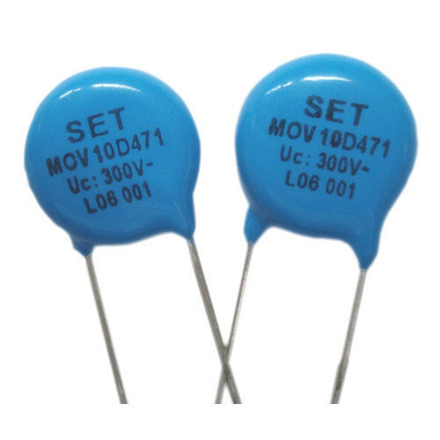
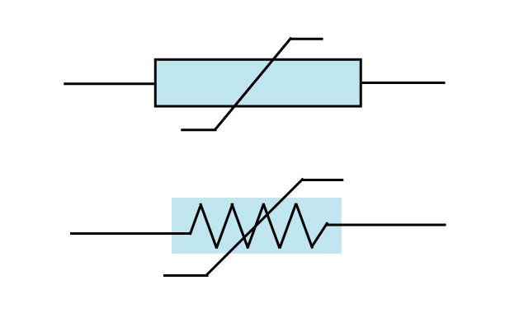
Varistors
A varistor is an electronic component whose resistance varies with the amount of voltage applied to it.
It is also called a voltage-dependent resistor.
At low voltage, the resistance of the varistor is usually high and decreases with increasing voltage.

Slide 39
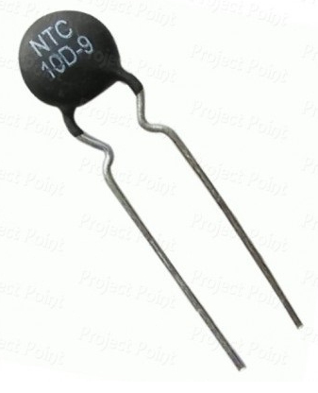
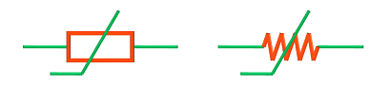
Thermistors
It is an electronic component whose resistance varies depending on the ambient temperature.
There are two types of thermistors: PTC, whose resistance increases with increasing ambient temperature, and NTC, whose resistance increases with decreasing ambient temperature.

Slide 40
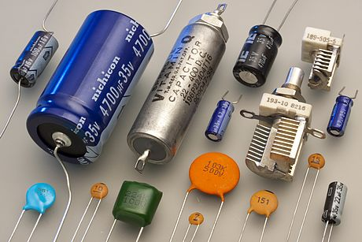
Capacitors and their types

Slide 41
What is a capacitor?
A capacitor is an element in an electrical circuit that can store electricity and supply it to the electrical circuit. It consists of two conductive electrodes of a certain shape with a layer of dielectric (rarely a semiconductor) between them. When a constant voltage is connected to the electrodes, they are charged, the dielectric polarizes and accumulates charges of the same size, but of the opposite sign - an electric field is created in the capacitor. The most important parameter of a capacitor is the electrical capacity. It is determined by the geometrical dimensions of the capacitor electrodes, the thickness of the layer of material between them and its dielectric constant

Slide 42
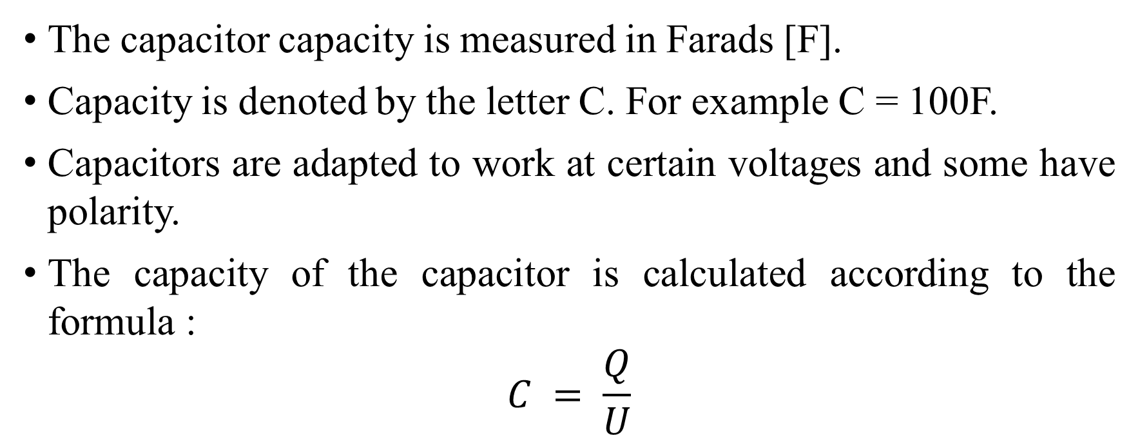
Capacitor specifications
The capacitor capacity is measured in Farads [F].
Capacity is denoted by the letter C. For example C = 100F.
Capacitors are adapted to work at certain voltages and some have polarity.
The capacity of the capacitor is calculated according to the formula :
$$C = \frac{Q}{U}$$
C- Capacity, Q- charge, U - voltage

Slide 43
Capacitor classification
Electrolytic capacitors.
Ceramic capacitors.
Adjustable capacitors.

Slide 44
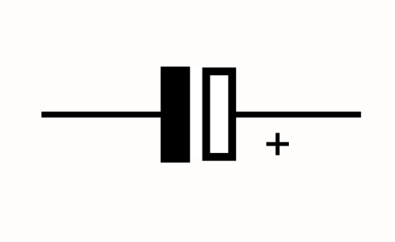
Electrolytic capacitors
Electrolytic capacitors have polarity, which means that one contact is connected to a positive voltage potential and the other to a negative one.
Electrolytic capacitors have a specified voltage that is the maximum it can support. Otherwise, it "burns" and is no longer usable.

Slide 45
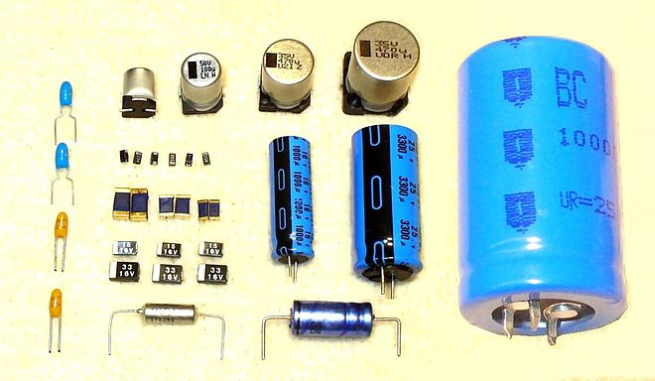
Electrolytic capacitors
They can store large amounts of energy and are commonly used to filter an electrical signal in both power supplies and amplifiers, or simply as a source of energy that can suddenly give it away, such as a camera flash.

Slide 46
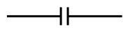
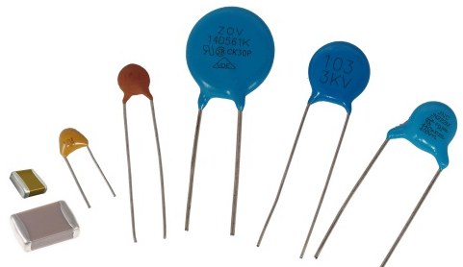
Ceramic capacitors
These capacitors have no polarity, so it does not matter which of the contacts will be connected to the positive voltage potential.
Because the dielectric is a ceramic layer, they are smaller than electrolytic capacitors and can take a variety of shapes.
Unlike electrolytic capacitors, which can have large capacities, ceramic capacitors are oriented to µF and smaller capacities.

Slide 47
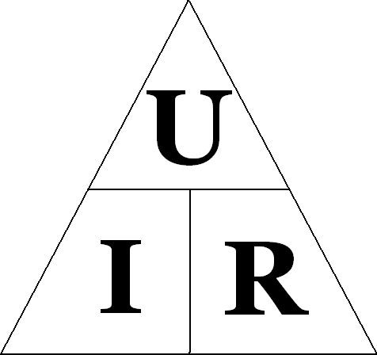
Ohm's law
A physical law that describes the relationship between voltage, current, and resistance in an electrical circuit. In other words, one of the most important formulas in electronics.
U – Voltage. Unit of measurement - Volts[V];
I – Current. Unit of measurement - Amperes[A];
R – Resistance. Unit of measurement - ohms[Ω]

Slide 48
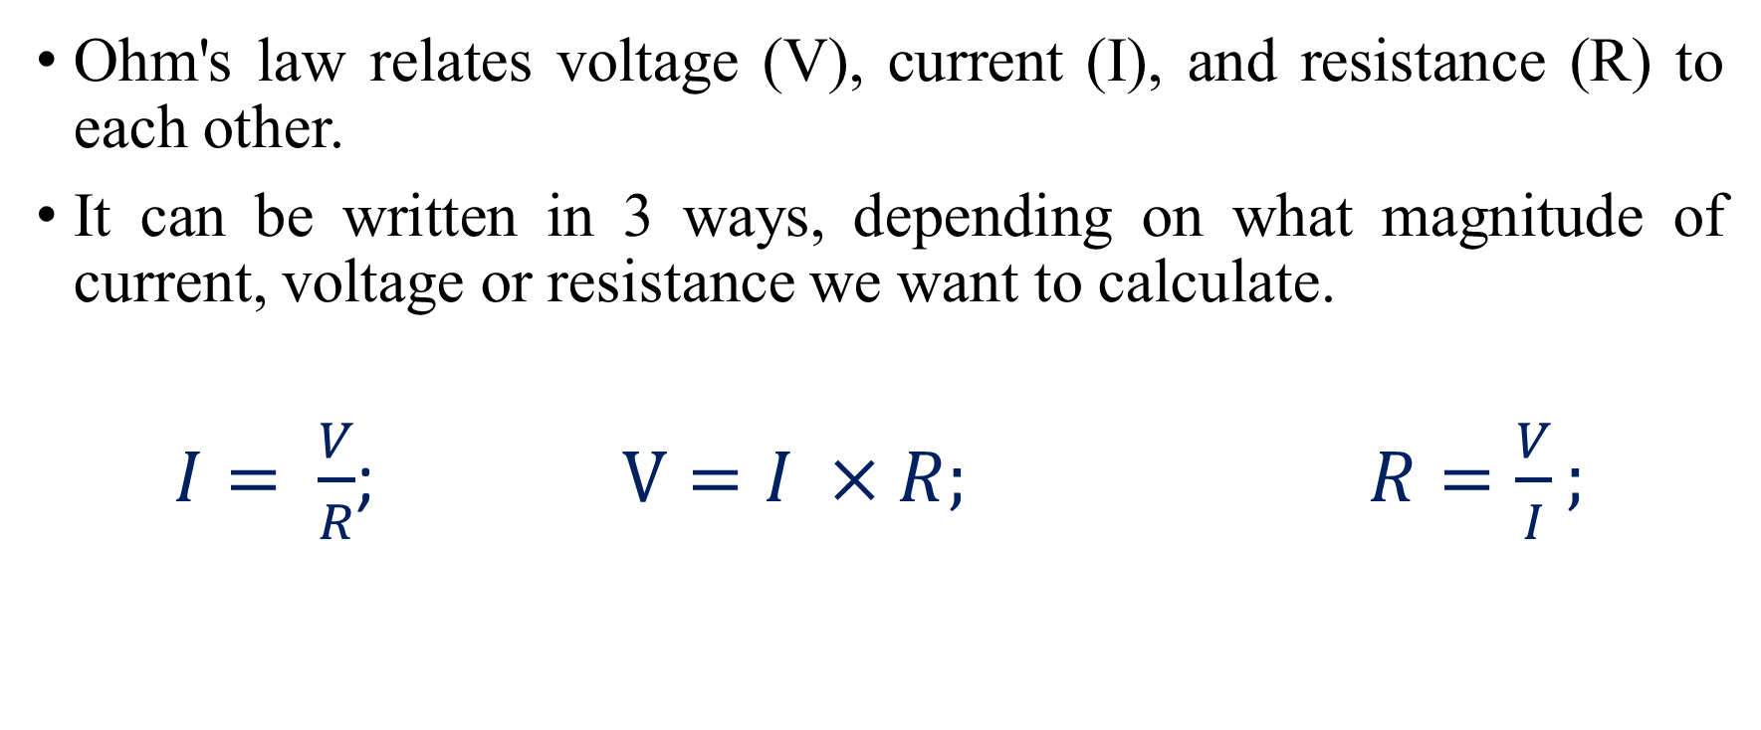
Expressions of the law of ohm
Ohm's law relates voltage (V), current (I), and resistance (R) to each other.
It can be written in 3 ways, depending on what magnitude of current, voltage or resistance we want to calculate.
$I= \frac{V}{R}$; $V=I ×R;$ $R=\frac{V}{I};$

Slide 49
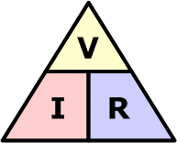
Ohm's law (triangle method)
If we want to find the voltage (V), cover V, you will see I and R, so V=I×R;
If we want to find the current (I), cover I, we will see V and R, so I=V/R;
If we want to find the resistance (R), cover R, we will see V and I, so R=V/I;

Slide 50
Use of Ohm's Law
Based on this law, voltage (V), current (I), resistance (R) can be calculated. Knowing the two parameters, one can easily calculate the third using the formulas mentioned above.
Suppose we want to connect a red light emitting diode (LED) to a 5 V line. The LED itself has its own specific voltage and current required for operation. The voltage required for the LED is 1.6 V and the current is 20 mA (20 mA = 0.02 A). According to the condition of the task, let's create a schematic diagram:

Slide 51
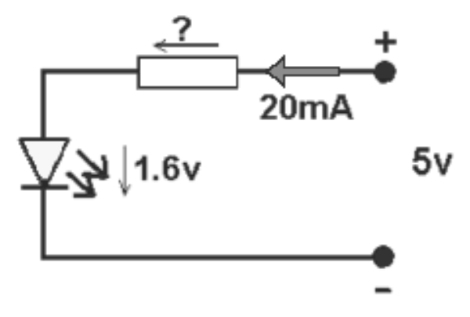
Use of Ohm's Law
So, we have a 5 V line, but the LED only needs 1.6 V, so the voltage needs to be reduced. This can be done using a properly sized resistor that will transform part of the voltage into heat.

Slide 52
Use of Ohm's Law
The LED must consume 1.6 V, in which case the voltage drop across the resistor must be 5 V - 1.6 V = 3.4 V. So we know the voltage (3.4 V) that the resistor has to convert to heat and the current of circuit (0.02 A).

Slide 53
Use of Ohm's Law
Next, applying one of the expressions R = V / I of the Ohm's law formulas, and setting the corresponding values, we obtain 3.4 V / 0.02 A = 170 Ω.

Slide 54
Use of Ohm's Law
However, often some of the calculated values do not have specific components, so you have to choose the closest value to the one that is produced. In our case, a suitable resistor of 180 can be obtained. When a 10 Ω larger resistor is connected, the LED will glow a little dimmer, as a current of less than 0.02 A will flow through it, but it is practically impossible to notice this.

Slide 55
Goodbye

